Slide 1


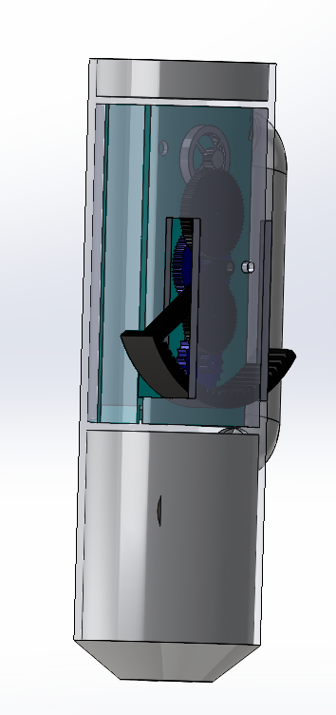
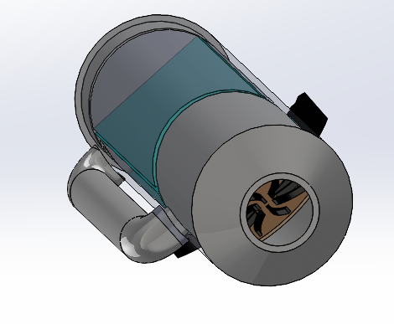
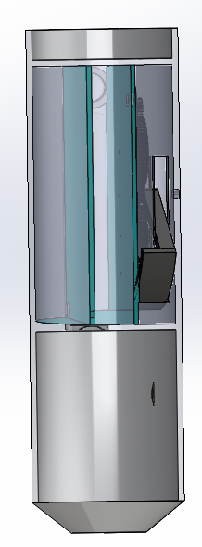
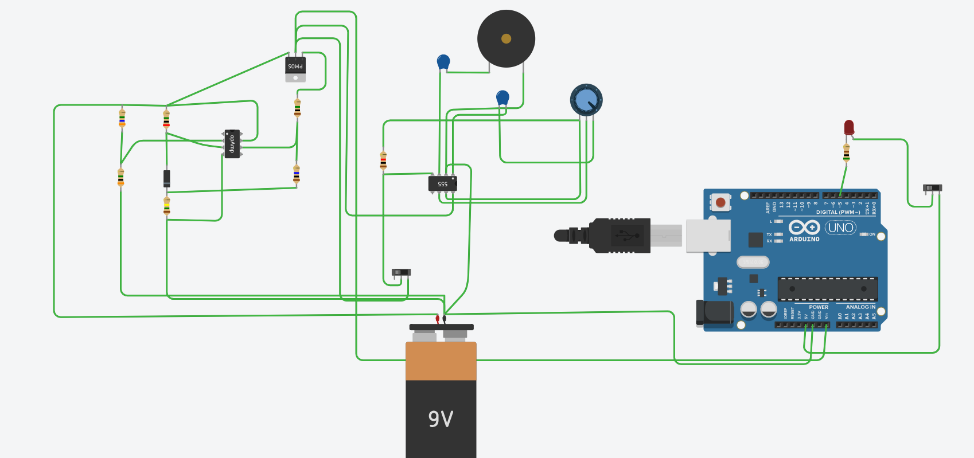
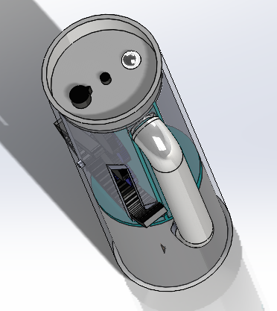
Project ID : IEEE BS-SHTPF P15
Chandravaran K, Saikumar D, Gayatri T, Aditya C
Guide: MS Bhat
Department of Electronics and Communication, Institution : NITK Surathkal, Place: Mangalore
IEEE NITK Student Branch
Abstract:
Experimental Set-up / Methodology ; Simulation / implementation Results & Discussion
The world around us is changing, and every day it becomes harder to get access to pure water. We who are living in urban areas have access to water purifiers, and we are privileged. Still, there are many places in the world and India where people have to walk many kilometers to get access to pure water on top of their heads; people should not be deprived of the essential thing that is required to survive. We have designed and simulated a device that can make clean drinking water easily accessible to all, including people residing in remote places. This device is portable and can be carried around easily. It does not have to be restricted to people living in rural areas, farmers can use it, and even hikers that need can't get fresh water quickly.
Objectives
This project aims to build a portable multipurpose water filter, which will help solve the problems of impure water supply in many India's villages. Many are being invested in bringing water to communities, we are providing a cost-efficient method to do so. It also aims to positively impact the fields of farming, adventure sports, and other such activities where carrying a lot of water is a burden.
the central compartment where it gets filtered and then finally goes into the last compartment where the water is stored, this can be seen in the leftmost picture. The circuits consists of three main sections. They are Battery management, SOS and High frequency emitter circuit. Battery management circuit is made with the use of Op-Amp(IC 741) as comparator to check battery level and the mosfet is used as a switch. SOS circuit and Battery management circuit are both powered up from the output of battery management circuit. SOS signal is generated using Atmega328P, an arduino is shown as TinkerCad did not have an Atmega328P. With the use of IC-555, a high frequency sound is generated, the potentiometer is used to control the frequency produced.
The above pictures are the 3-D model of the device that has been designed. The left side picture is the back view of the equipment. It shows the gear system, this gear system moves by the hand crank mechanism and increases the rpm the base rpm of the hand crank mechanism, which is connected to a set of magnets that get rotated and cause electromagnetic induction, this electricity produces id stored in Lipo battery, which is connected to the battery management system, this stores electricity which is used to power all the electronic components. In the top center picture, you can see the centrifugal fan which is powered by a motor, after dipping the device in the water we move the hand crank which starts the motor, the water starts going through the pipe and into
Introduction
This project comprises of 2 main parts the mechanical design where the biggest problem is making a small and straightforward model to realize our objective. This was designed on SolidWorks. The electronics part consists of 3 components the High-frequency emitter, the Led light, and the battery management system. The trickiest part is electromagnetic induction. We have magnets rotating around copper wires and inducing the electric current; the magnets are moved with the help of a gear system that keeps on increasing the rpm by 4-6 times from the base rpm of the hand crank mechanism.
Impact of the proposed solution on society, environment, heath, safety etc
Conclusions
Scope of the water filter :
The filter can help reduce the burden of carrying a lot of potable water in remote area with less access to water.
This can also be used by farmers and people in areas with infected water.
Scope of the flashlight :
When the women is rural area so to get water they leave early in the morning and it will be hard to see the path in front of them
Scope of the SOS module :
The SOS module can be used to send an SOS signal in case of emergencies. It can be used in various fields during various kinds of emergencies such as injuries, animal attacks, fires etc.
Scope of the High frequency module :
This last safety measure is a high frequency emitter to keep the animals at bay.
we want to state that as we keep moving forward in time, there will come a time where getting clean water will be a problem, then we would require a device that we have proposed. This project has been designed looking at that future.
The multipurpose water filter can help solve many problems related to water management and improper water supply. Many lifes are benefitted and this can help increase the overall development of the country. Many sectors such as farming can benefit from this project and this ultimately makes the world a better place.
Future Work
Hardware implementation of the design and testing its functions. One more idea would be to make it a IoT device, we can add a gsm module, to relay information.
Literature Gaps
There are many literature gaps, as we have not gone into the phase of implementing it in real life; there can be many problems. There is a scope to make this device an IoT device by including a GSM module and relay the information or the location of the person. One more area that would be a problem will be the waterproofing and trying to make the whole thing modular. We can also keep UV light so that it can kill the germs present in the water.
Acknowledgments
We would like to express our sincere thanks to IEEE Bangalore Section for this providing us with this opportunity. We would like to express our sincere gratitude to Prof M S Bhat, Dr U C Niranjan and Samarth Bonthala for their support and guidance all throughout the execution of this project.

